Slide 1
Synchrotron Radiation and LIGHT SOURCES
Eric Prebys, UC Davis

Slide 2
Synchrotron Radiation
For a relativistic particle, the total radiated power (S&E 8.1) is
In a magnetic field
Electron radiates 10¹³ times more than a proton of the same energy!

Slide 3
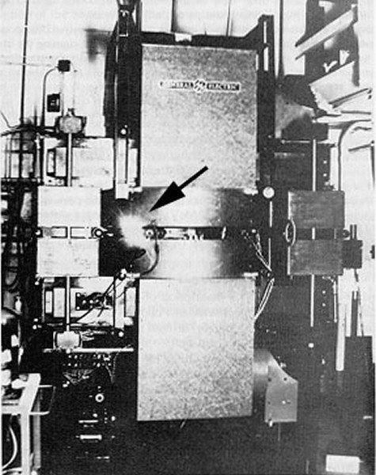
First Observation of Synchrotron Radiation
The first attempt to observe synchrotron radiation was in 1944 at the 100 MeV GE betatron
Because of a miscalculation, they were looking in the microwave region rather than the visible (in fact the walls were opaque), so although the say an energy decay, they did not observe the radiation.
Synchrotron radiation was first successfully observed in 1947 by Elder, Gurewitsch, and Langmuir at the GE 70 MeV electron synchrotron.

Slide 4
Effects of Synchrotron Radiation
Two competing effects
Damping
Quantum “heating” effects related to the statistics of the photons
energy
damping time
energy lost per turn
period
Number of photons per period
Rate of photon emission
Average photon energy

Slide 5
Power Spectrum of Synchrotron Radiation
The power spectrum of radiation is given by
“critical frequency”
Modified Bessel Function
Differential photon rate
“critical wavelength”
“critical energy”

Slide 6
Some Handy Numbers (don’t bother to memorize)
The total rate is:
The mean photon energy is then
The mean square of the photon energy is
The energy lost per turn is

Slide 7
Example: The Failed Experiment
In 1944 GE looked for synchrotron radiation in a 100 MeV electron beam.
Assume B=1T
We have
E≈pc=100 MeV
mc²=.511 MeV
γ=E/(mc²) = 196
(Bρ)=100/300=.333 T-m
ρ=(Bρ)/B=.333 m
eV-m
eV-μm
Visible yellow light, NOT microwaves

Slide 8
It’s important to remember that ρ is not the curvature of the accelerator as a whole, but rather the curvature of individual magnets.
So if an accelerator is built using magnets of a fixed radius ρ₀, then the energy lost per turn is
For electrons
“isomagnetic”
Example: CESR
photons/turn

Slide 9
Effects of Synchrotron Radiation
Two competing effects
Damping
Quantum “heating” effects related to the statistics of the photons
energy
damping time
energy lost per turn
period
Number of photons per period
Rate of photon emission
Average photon energy

Slide 10
Small Amplitude Longitudinal Motion
Particles lose more energy at the top of this cycle than the bottom
Reaccelerate
Energy lost and smaller amplitude
Smaller amplitude
Heating term due to statistical fluctuations
damping term

Slide 11
Evaluate integral in damping term
Recall
Dependence of field
Can’t ignore anything!!

Slide 12
Putting it all together…
use

Slide 13
Reminder: Damping + Heating
In general, if I have a simple damping force of the form
the solution is
If I add a constant heating term

Slide 14
Result
damping
heating
The energy then decays in a time

Slide 15
Longitudinal Damping in a “Normal” Synchrotron
So far we have talked about “separated function”, “isomagnetic” lattices, which has
A single type of dipole:
Quadrupoles:
In this case
probably the answer you would have guessed without doing any calculations.

Slide 16
Equilibrium Energy Spread
We can relate the spread in energy to the peak of the square with

Slide 17
This leads to

Slide 18
Damping in the Vertical Plane
Synchrotron radiation
Energy lost along trajectory, so radiated power will reduce momentum along flight path
If we assume that the RF system restores the energy lost each turn, then
Energy lost along the path
Energy restored along nominal path ➔”adiabatic damping”

Slide 19
Damping in the Vertical Plan (cont’d)
The math follows much like the case of adiabatic damping, and we find that
Unlike the longitudinal plane, there is no heating term, so in the absence of coupling, the emittance would damp to zero in the vertical plane.
This turns out to a problem for stability

Slide 20
Horizontal Plane
The horizontal plane has the same damping term as the vertical plane, but it has more contributions because the position depends on energy
betatron motion
where
If we radiate a photon of energy u, it will change the energy, but not the position or the angle.

Slide 21
Result in Horizontal Plane
Skipping a lot of math, we get
Same as longitudinal plane
Separated function isomagnetic synchrotrons

Slide 22
Equilibrium Emittance in X
The equilibrium emittance is given by
For a separated function, isomagnetic machine, this becomes
With some handwaving, this can be approximated by

Slide 23
Robinson’s Theorem
Note:
This is called Robinson’s theorem and it’s always true. For a separated function, isomagnetic lattice, it simplifies to

Slide 24
Cheat Sheet Summary
For a separated function, isomagnetic synchrotron
Energy lost per turn
Longitudinal damping time
Transverse damping times
Robinson’s Theorem (always true)
Equilibrium energy spread
Equilibrium horizontal emittance

Slide 25
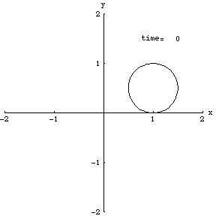
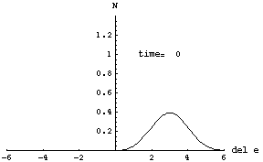


Benefits of Damping
Can inject off orbit and beam will damp down to equilibrium
Don’t have to worry about painting or charge exchange like protons.
Can inject over many turns, or even continuously.
Beams will naturally “cool” (i.e. reduce their emittance in phase space)
Example: Beams injected off orbit into CESR

Slide 26
Considerations for e⁺e⁻ Colliders
In the case of proton-proton and proton-antiproton colliders, we assumed
The optics were the same in the two planes
The emittances were the same in the two planes
The normalized emittance was preserved.
This allowed us to write
In general, none of this will be true for e⁺e⁻ colliders.
The emittance will be much smaller in the y plane
Because the emittance is large in the x plane, we will not be able to “squeeze” the optics as far without hitting the aperture in the focusing triplet, so in general, β*_{x}>β*_{y}.
We must write
Unnormalized(!) emittance

Slide 27
Synchrotron Light Sources
Shortly after the discovery of synchrotron radiation, it was realized that the intense light that was produced could be used for many things
Radiography
Crystallography
Protein dynamics
…
The first “light sources” were parasitic on electron machines that were primarily used for other things.
As the demand grew, dedicated light sources began to emerge
The figure or merit is the “brightness”

Slide 28
First Generation: Parasitic Operations
These just used the parasitic synchrotron light produced by the bend dipoles
Examples
SURF (1961): 180 MeV UV synchrotron at NBS
CESR (CHESS, 70’s): 6 GeV synchrotron at Cornell
Numerous others
Typically large emittances, which limited brightness of the beam

Slide 29
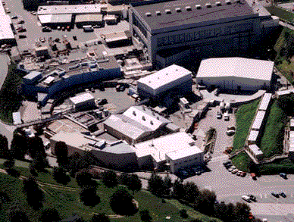
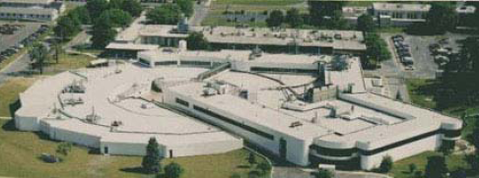
Second Generation: Dedicated
Examples:
1981: 2 GeV SRS at Daresbury (ε=106 nm-rad)
1982: 800 MeV BESSY in Berlin (ε=38 nm-rad)
1990: SPEAR II becomes dedicated light source (ε=160 nm-rad)
Often include “wigglers” to enhance SR

Slide 30
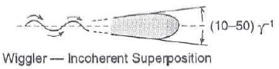
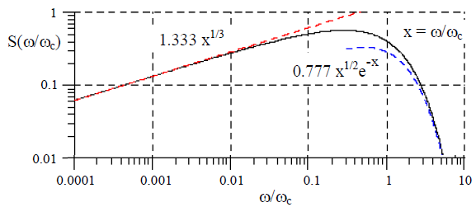
Typical 2nd Generation Parameters
Beam sizes
σ_{y}~1 mm
σ_{y’}~.1 mrad
σ_{x}~.1 mm
σ_{x‘}~.03 mrad
Broad spectrum
High flux
Typically 10¹³ photons/second/mradian for 3 GeV, 100 mA dipole source at E_{crit}

Slide 31
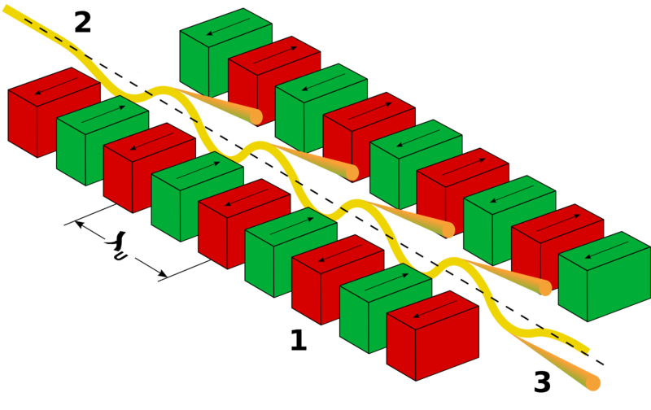
Undulators
Periodic Magnets
In rest frame of electron
Electron oscillates coherently with (contracted) structure, and releases photons with the same wavelength.
In the lab frame, this is Doppler shifted, so
So, λ on the order of 1cm ➔X-rays.

Slide 32
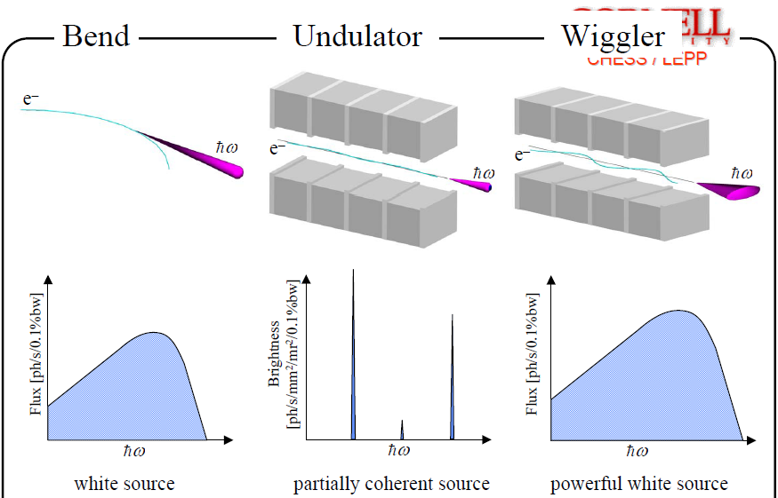
Bends, Undulators, and Wigglers*
*G. Krafft

Slide 33
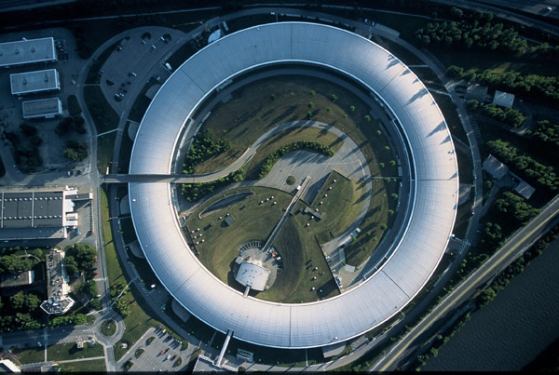
3rd Generation (Undulator) Sources
High Brightness
10¹⁹ compared to 10¹⁶ for 2nd generation sources
Emittance ~1-20 nm-rad
A few Examples:
CLS
SPEAR-III
Soleil
Diamond
APS
PF
NSLS
BESSY
Doris
…
European Synchrotron Radiation Facility (ESRF)

Slide 34
Fourth Generation
Fourth Generation light sources generally utilize free electron lasers (FELs) to increase brightness by at least an order of magnitude over Third Generation light sources by using coherent production

Slide 35
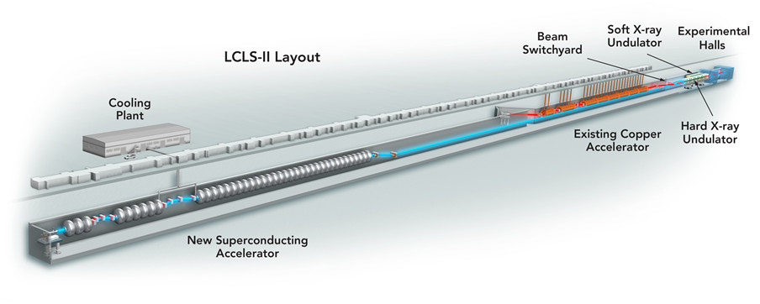
Next Big Thing in the US.
LCLS-II at SLAC
4 GeV superconducting linac
1 MHz operation
X-rays up to 25 keV

Slide 36
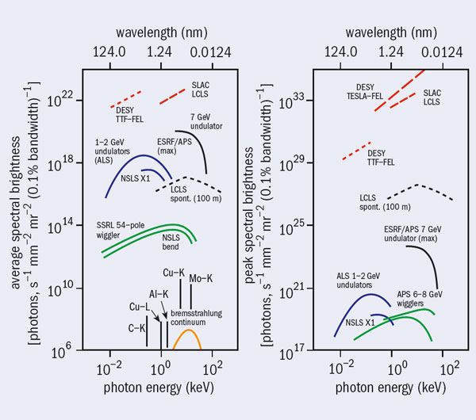
Evolution of Parameters

Slide 37
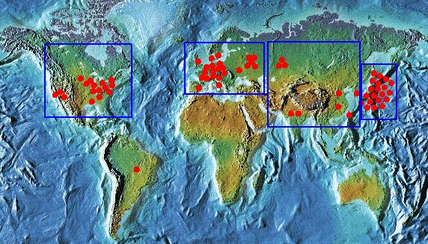
Light Sources are a Huge (and growing) Industry
Wikipedia lists about 60 light sources worldwide

